Slide 1

DHCP SERVER
Dynamic Host Configuration Protocol

Slide 2
Table of content
Introduction
Uses
Features
Objectives
Advantages and Disadvantages
How does it work

Slide 3
introduction
DHCP stands for Dynamic Host Configuration Protocol.
It helps devices automatically get an IP address when they connect to a network.
It removes the need for entering network settings manually.
Useful for networks where many devices connect daily.
Ensures the right IP, gateway, and DNS are assigned.
Makes the network easy to manage and reduces technical errors.
Works silently in the background without user interaction.

Slide 4
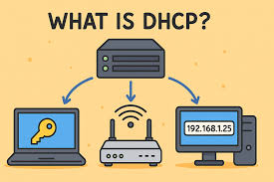
introduction
DHCP is a network protocol that automatically assigns IP addresses and other network settings to devices on a network.
When a laptop, phone, or any device connects to a network, DHCP makes sure it receives:
IP Address
Subnet Mask
Default Gateway
DNS Server
Lease Time
Automatically, without any manual configuration.

Slide 5

Uses of DHCP server
Assigns IP addresses to devices automatically
Helps avoid IP clashes between multiple systems
Makes connecting new devices fast and effortless
Centralizes all network configuration in one place
Reduces workload on network administrators

Slide 6
Features of DHCP server
Provides dynamic and automatic IP assignment
Offers IP address reservations for specific devices
Renews and releases IP when required
Supports multiple networks through DHCP scopes
Allows DHCP relay for remote networks
Scalable for any environment

Slide 7
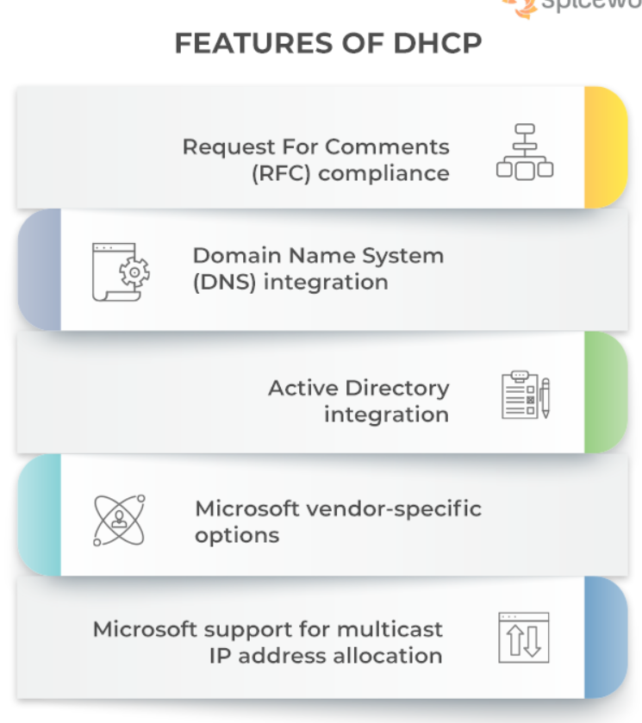
Features of DHCP server
Automatic IP Assignment: Assigns unique IPs without manual effort.
Dynamic IP Allocation: Reuses expired IPs to optimize IP usage.
Centralized Management: All IP settings are managed by a single server.
Lease Mechanism: Provides IPs for limited time (lease).
Supports Multiple Parameters:
IP Address
Subnet Mask
Default Gateway
DNS Servers
Lease Time
Supports Static IP Reservation: Specific IP assigned to specific device (MAC-based).
Scalable: Works for home networks as well as enterprise networks.

Slide 8
Objectives of a DHCP server
To simplify network setup and configuration
To remove the need for manual IP entry on each device
To ensure consistent and accurate network settings on each device
To prevent IP address conflicts within the network
To make device connectivity quick and smooth
To reduce human errors caused during manual configuration
To support growing and frequently changing networks easily

Slide 9
Advantages and disadvantages
Advantages
Disadvantages
Saves a lot of time by automating IP assignment.
Reduces mistakes that happen during manual configuration.
Helps network admins control everything from one place.
Connects new devices instantly with no setup required.
Supports mobiles/laptops that keep switching networks.
Efficient in large networks with thousands of devices.
Makes network changes easier and faster.
If the DHCP server goes down, new devices can’t get IPs.
Does not offer built-in security or authentication.
Networks can be attacked by rogue (fake) DHCP servers.
Heavy broadcast traffic in large networks.
Not suitable for systems that require permanent static IPs.
Requires proper management to avoid misuse.

Slide 10
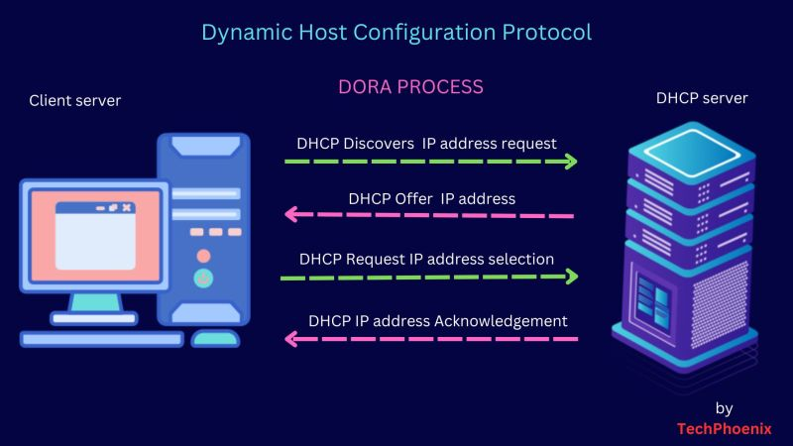

Slide 11
How DOES DORA PROCESS works
1. Step 1: DISCOVER (Client → DHCP server)
2. Step 2: OFFER (DHCP server → Client)
3. Step 3: REQUEST (Client → DHCP server)
4. Step 4: ACK (DHCP server → Client)

Slide 12
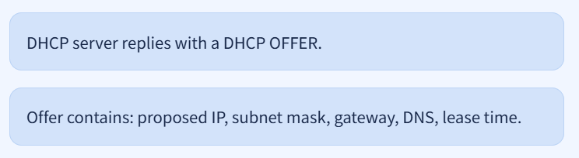
1. Step 1: DISCOVER (Client → DHCP server)
2. Step 2: OFFER (DHCP server → Client)

Slide 13
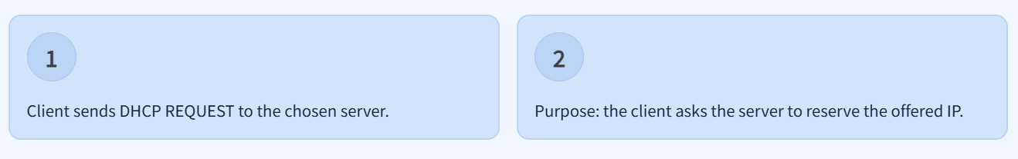
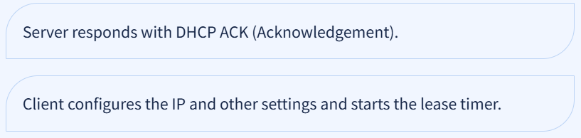
3. Step 3: REQUEST (Client → DHCP server)
4. Step 4: ACK (DHCP server → Client)

Slide 14
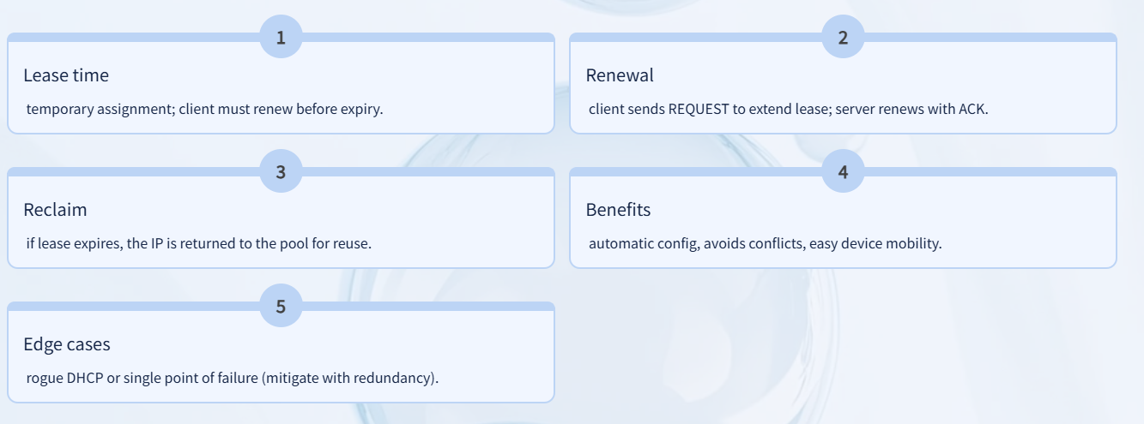
PROPERTIES OF DHCP

Slide 15
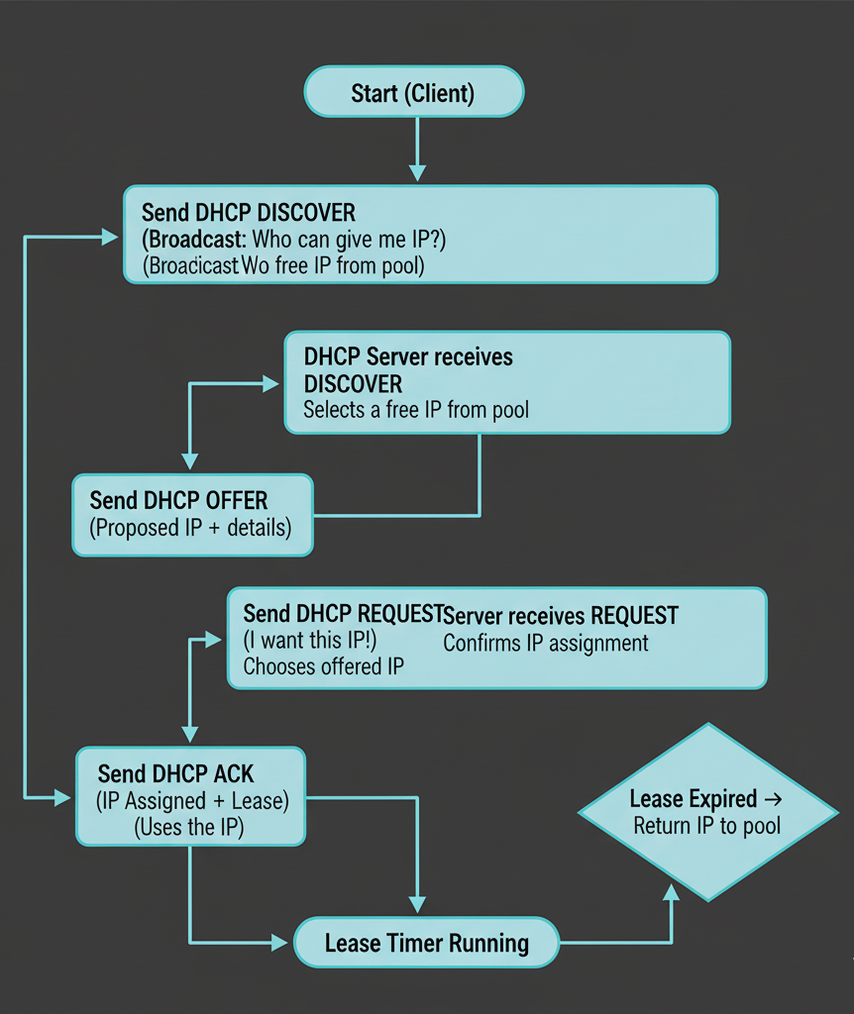
How DHCP Works When There Is Lease Timer

Slide 16
REAL LIFE EXAMPLE (OUR PROJECT SCENARIO)
Laptop A → DHCP Server Laptop B → DHCP Client
Laptop B sends “DISCOVER”
Laptop A offers “192.168.1.10”
Laptop B requests it
Laptop A acknowledges and starts 30 sec lease timer
After 30 sec, Laptop A frees the IP and returns it to pool

Slide 17
PRACTICAL IMPLEMENTATION
TOPIC:-
Dynamic IP Allocation & LAN Communication System Using Python
AUTO ASSIGNING IP ADDRESS
LEASE TIMEOUT OF 30sec
CHAT BETWEEN SERVER AND CLIENT

Slide 18
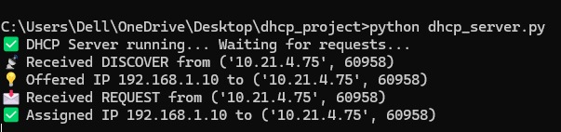
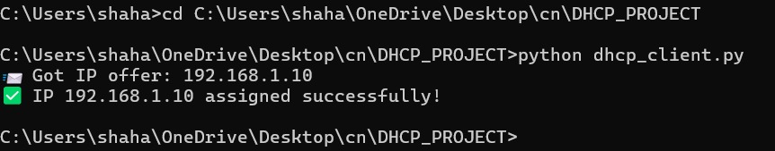
OUTPUT OF CONNECTIVITY
SERVER SIDE
CLIENT SIDE

Slide 19
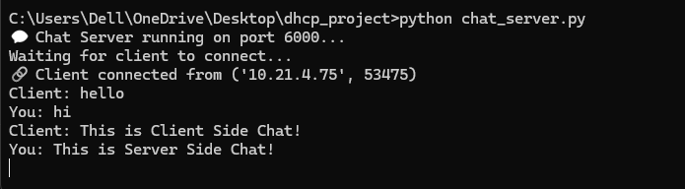
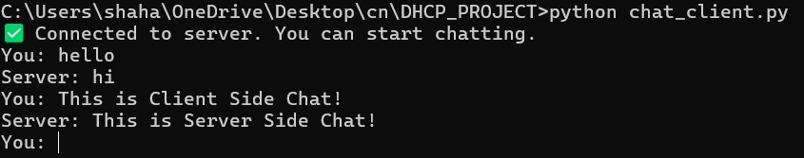
OUTPUT OF CHAT BETWEEN SEVER AND CLIENT
SERVER SIDE
CLIENT SIDE

Slide 20
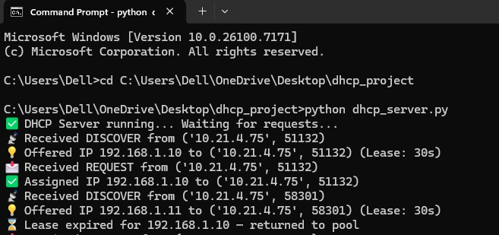
LEASE TIMEOUT OF 30 seconds

Slide 21

Thank You
25MCA047@nirmauni.ac.in
25MCA066@NIIRMAUNI.AC.IN

